Slide 1
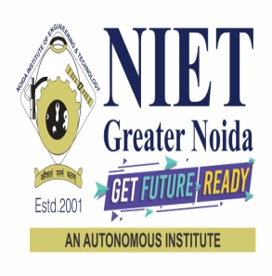

Industrial Presentation on 5G Technology
By
1.Shivani Kumari
(1901330310143)
Under the Supervision of
Mr. Manish Kumar
Assistant Professor (ECE)
Department of Electronics and Communication Engineering
Noida Institute of Engineering and Technology, Greater Noida

Slide 2
Outline
Introduction
Evolution
Why 5G?
5G NR(New Radio)
Service Class
5G Core Network
5G Techniques
5G Network Principle and Feature
Application

Slide 3
Introduction to 5G
5G is the 5th generation mobile network.
It is a new global wireless standard after 1G, 2G, 3G, and 4G networks.
5G enables a new kind of network that is designed to connect virtually everyone and everything together including machines, objects, and devices.
5G wireless technology is meant to deliver higher multi-Gbps peak data speeds, ultra low latency, more reliability, massive network capacity, increased availability, and a more uniform user experience to more users.
Higher performance and improved efficiency empower new user experiences and connects new industries.

Slide 4
Invention of 5G
No one company or person owns 5G, but there are several companies within the mobile ecosystem that are contributing to bringing 5G to life. Qualcomm has played a major role in inventing the many foundational technologies that drive the industry forward and make up 5G, the next wireless standard.
We are at the heart of the 3rd Generation Partnership Project (3GPP), the industry organization that defines the global specifications for 3G UMTS (including HSPA), 4G LTE, and 5G technologies.
3GPP is driving many essential inventions across all aspects of 5G design, from the air interface to the service layer. Other 3GPP 5G members range from infrastructure vendors and component/device manufacturers to mobile network operators and vertical service providers.

Slide 5
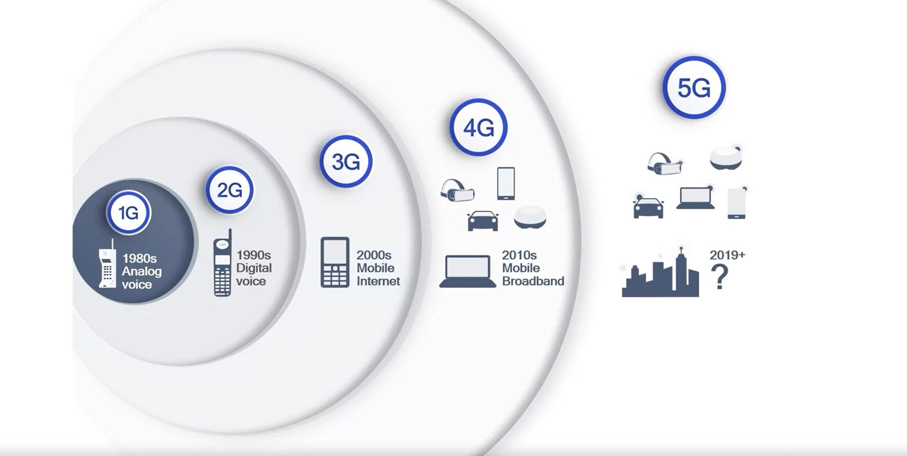
Evolution

Slide 6
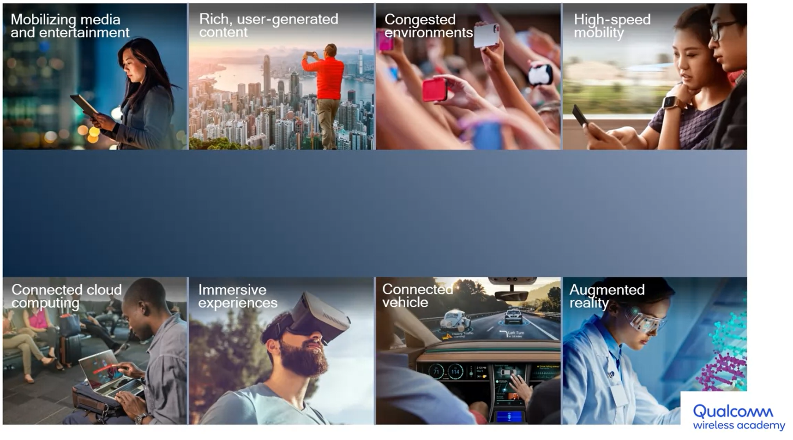
Why do we need something beyond 4G?

Slide 7
Why do we need something beyond 4G?
Mobilizing media and entertainment.
Rich, user-generated Content.
For more data rate in congested environment.
High-speed mobility.
Connected cloud computing.
Immersive experience.
Connected-Vehicle.
Augmented reality

Slide 8
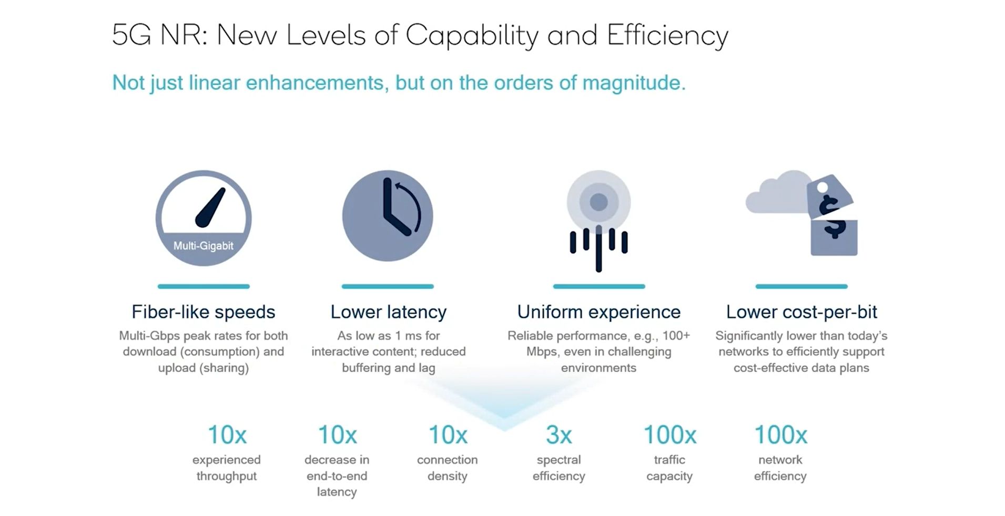
5G NR(New Radio)

Slide 9
5G NR Service Classes
Service classes is considered as umbrellas of applications or use cases, each of which shares some commonalities with other applications under the same umbrella.
There are three main service classes in 5G.
eMBB or enhanced mobile broadband.
mMTC or massive machine type communications, also known as mIoT or massive IOT.
URLLC, ultra reliable low latency communications.

Slide 10
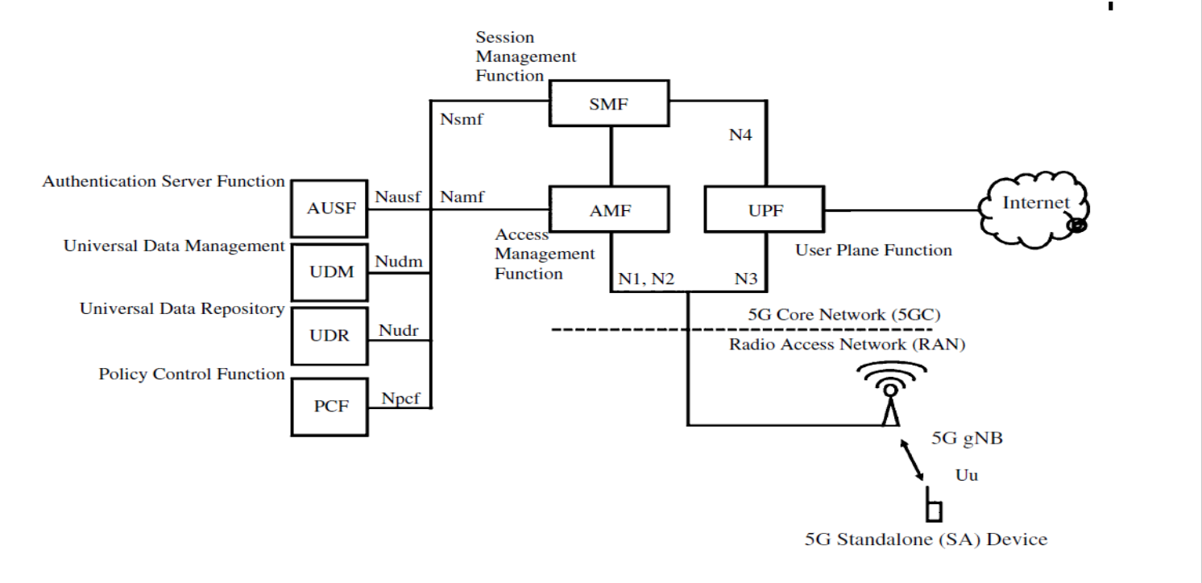
5G Core Network

Slide 11
5G Core Network
Previous Figure gives an overview of the most important components of the 5GC that are required for a basic network.
• From a high-level point of view, the 5G core network is very similar to the LTE core network.
• To distinguish it from previous network generations, all network entities in the 5GC have received new names and abbreviations.
• As in the 4G core network, the architecture is split into the signaling plane and the user plane.
• The user plane is the logical part of the network that transports the user data traffic, i.e., it provides network connectivity.
• In most cases, this means that the user plane provides Internet connectivity to the UE.

Slide 12
5G Core Network
• Signaling plane: It is used by all network components and the UE for management tasks such as
connection management
mobility management
session management.
• In the 5G core, network functions have been defined in a way to allow them to be split into smaller services which can then be run in a cloud environment, i.e., in virtual machines and containers in data centers.
• The 4G Mobility Management Entity (MME) has been split into two individual 5G functions; the Access Management Function (AMF) and the Session Management Function (SMF). The UE sends connection, mobility, and session related information to the AMF.

Slide 13
5G Core Network
• The AMF then handles connection and mobility management tasks and forwards all messages related to session management to the SMF.
• The 4G HSS(Home Subscriber Server) has been split into three separate 5G functions: the front-end to the AMF is the Authentication Server Function (AUSF); while the subscription data is accessed and managed via the Universal Data Management (UDM) function. The data itself is stored in the Unified Data Repository (UDR).
• User plane : In the user plane components that forward user data packets between a UE and an external network.
• The 5G User Plane Function (UPF) work to connect the actual data coming over the RAN to the Internet.

Slide 14
5G Core Network
• The Authentication Server Function (AUSF) is in a home network and performs authentication with a UE. It makes the decision on UE authentication.
• Access and Mobility Management Function (AMF):- primary tasks include
Connection Management
Mobility Management
• SMF stands for Session Management Function. Following are the functions of 5G NR SMF node.
Session Management;
UE IP address allocation and management;
Configures traffic steering at UPF to route traffic to proper destination;

Slide 15
5G Core Network
• Unified Data Management(UDM) :- Functions of UDM
User Identification Handling
Generation of Authentication Credentials
Subscription management.
SMS management
UPF stands for User plane function
Packet routing & forwarding
• Policy Control Function (PCF): responsible for Quality-of-Service management of user data bearers. • This network element is responsible to assign bearer parameters such as the maximum overall speed of a connection and which priority each bearer shall have in case of congestion.

Slide 16
5G Core Network
• Network Interfaces:- To allow network operators to buy the different core network functions from different manufacturers, it is necessary to standardize the interaction between them.
• The following interfaces have been standardized between the 5G RAN and the 5GC as shown in Figure
• N1: UE, AMF and SMF;
• N2: gNB and AMF;
• N3: gNB and UPF;
• N4: SMF and UPF.

Slide 17
5G Core Network
• Between the control plane core network functions, a different set of interfaces is used:
• ●● Namf: To communicate with the Access Management Function;
• ●● Nsmf: To communicate with the Session Management Function.
• ●● Nausf: To communicate with the Authentication Function (AUSF);
• ●● Nudm: To communicate with the Universal Data Management;
• ●● Nudr: To communicate with the Unified Data Repository (UDR);
• ●● Npcf: To communicate with the Policy Control Function (PCF).

Slide 18
5G Techniques
Some of the principal techniques that provide some of the most significant improvements in 5G performance are
Flexible-slot Based
Scalable OFDM-Based Air
Advanced Channel Coding
Massive MIMO
Mobile mmWave

Slide 19
Massive MIMO
Massive MIMO (massive multiple-input multiple-output) is a type of wireless communications technology in which base stations are equipped with a very large number of antenna elements to improve spectral and energy efficiency.
Massive MIMO systems typically have tens, hundreds, or even thousands of antennas in a single antenna array.
Other technologies such as beamforming and spatial multiplexing enable massive MIMO as one of the key technologies for 5G NR systems.
Benefits of Massive MIMO :-
Improved coverage at cell edge
Improved throughput
Enabled by millimeter wave

Slide 20
Millimeter Wave
Millimeter waves are electromagnetic (radio) waves typically defined to lie within the frequency range of 30-300GHz.
The microwave band is just below the millimeter-wave band and is typically defined to cover the 3–30-GHz range.
Signal wavelength is measured in millimeters.
mmWave Spectrum is mostly unused.
Unused spectrum offers abundant bandwidth.
Solving the problem of scarcity for wireless devices.
For extreme capacity and throughput.

Slide 21
5G Network Principle And Feature
Network Slicing
SDN(Software-Defined Networking)
NFV(Network Functions Virtualization)
MEC(Mobile Edge Computing)

Slide 22
Network Slicing
A slice is a subset of the available network components that can provide an E2E service.
A slice can be designed and commissioned depending upon the needs of a service.
Diverse requirements of different services can be met by serving them with different slices of the same network, i.e different components of the same infrastructure.
Benefits
Dynamic and efficient resource allocation and utilization; resource isolation among services.
Flexible subscription models.

Slide 23
SDN
SDN is an emerging network architecture
Network control functions/tasks are decoupled from network devices.
Migration of control, from individual network devices into accessible distributed computing devices/functions.
Underlying infrastructure can be abstracted for different applications and network services
Benefits
Centralized management and control of Network devices.
Rapid innovation on new network capabilities and services.
Programmability by different users and developers
Increased network reliability and security.

Slide 24
NFV
Up to 4G, networks required specialized software running on specialized hardware.
NFV aims to transform network architecture.
Involves implementation of network functions(NF) in software.
NFs can run on a range of industry-standard server hardware.
NFs can reside in a cloud, instead of on the operator premises.
Benefits
Decoupling software from hardware.
Flexible, scalable , dynamic network deployments.
Cost-effective operation.

Slide 25
Edge Computing
Edge Computing brings compute, storage, and networking resources closer to applications, devices and users.
Shifts of resources from centralized data centres far away from the end user to the network edge.
Can facilitate services with strict latency, security, and banwidth requirements.
SDN,NFV, and 5G technologies promote the development of edge computing.
Edge Computing is a broader concept not lied to, or dependent on, a specific generation of cellular communication.

Slide 26

Noida Institute of Engineering and Technology, Greater Noida

